Slide 1
Plotly and ggplot2 in R
Annabel Westermann

Slide 2
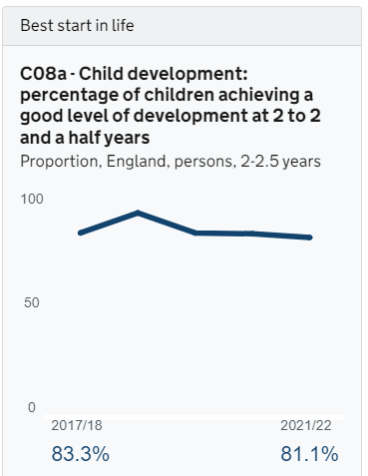
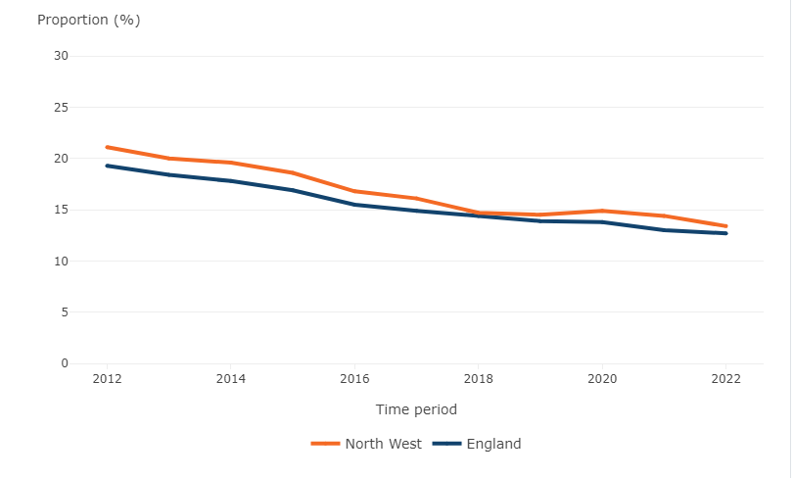
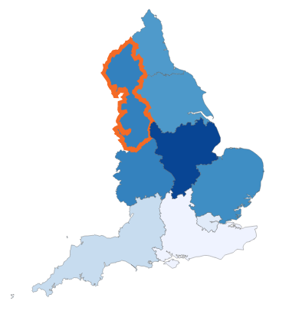
Using plotly, ggplot2 and and sf
Used Plotly for interactive charts
Used ggplot2 for creating SVG chart images (as Plotly R doesn’t work for this?)
Use ggplot2 with ggplotly to create interactive choropleth maps because of file size issues and ease of geom_sf()

Slide 3
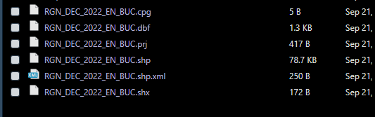
File size issues
Typically you will use GeoJSON or shapefiles for maps (discussion of comparison)
You can do choropleth maps with Plotly, but they seem to need GeoJSON and I was having issues with the file size as the map is the whole of the UK (although this is perhaps later resolved)
Leaflet also seems to favour GeoJSON and it looked less ‘clean’ to me with borders and backgrounds
It turns out you can actually access various file sizes on Open Geography Portal
Shapefiles still seem smaller
Need all 6 files but read in just .shp with st_read() from sf library
Create ggplot2 object with geom_sf()
Make interactive with ggplotly()

Slide 4
Useful links (thanks to all contributors!)
Plotly R helper pages (link)
Reference index in R Plotly (helps with the structure of the functions and the add on parts Annabel mentioned) (link)
Quarto reference documentation: rendering (link)
Leaflet maps: CaroDB base layer (link)
Plotting a tilted map in R (link -- StackOverflow)
R, Plotly, and Shiny (link)

